Slide 1
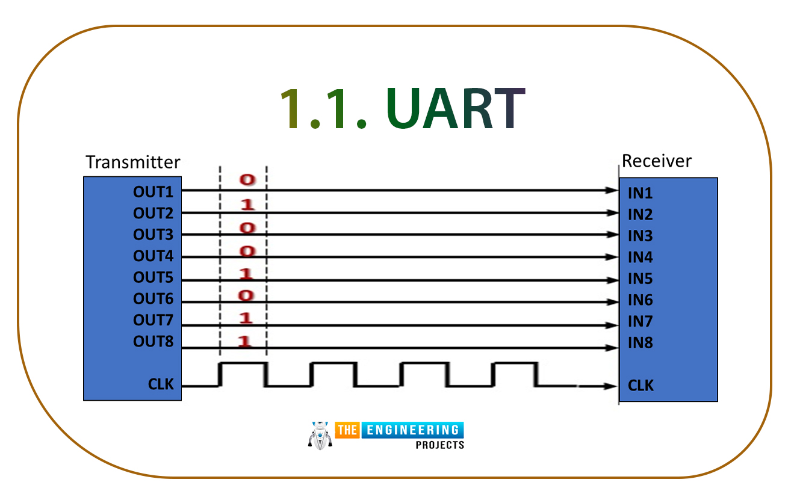
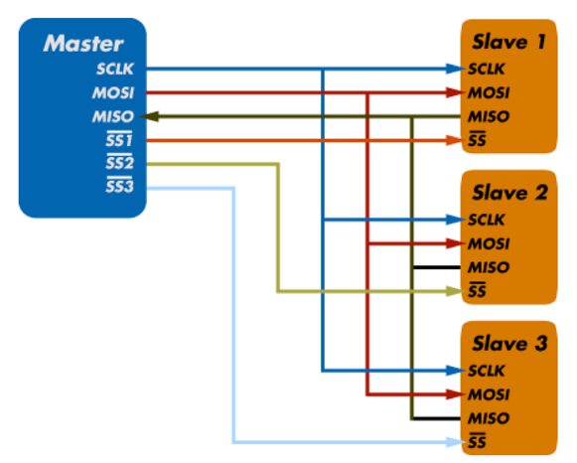
Section 2: UART - SPI - I2C

Slide 2
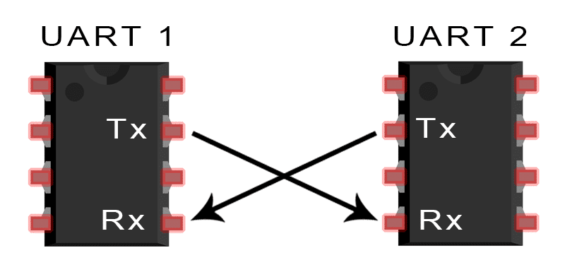
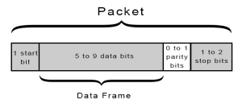
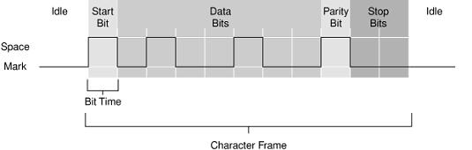
Serial Communication using UART
The most popular connection in hardware devices
UART vs USART

Slide 3
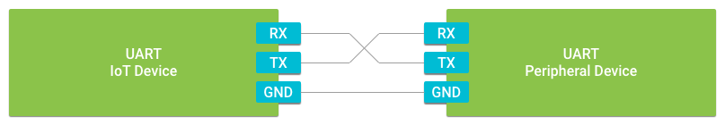
UART Device Driver on Android Things
UART stands for Universal Asynchronous Receiver Transmitter
It is universal because both the data transfer speed and data byte format are configurable.
It is asynchronous in that there are no clock signals present to synchronize the data transfer between the two devices
UART data transfer is full-duplex, meaning data can be sent and received at the same time

Slide 4
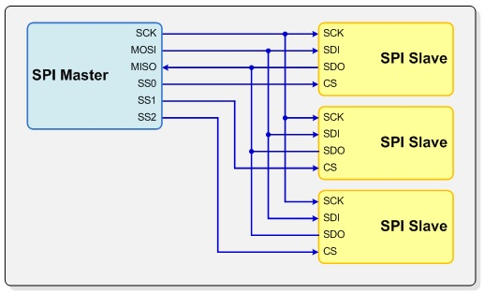
Serial Communication using SPI
Serial Peripheral Interface (SPI) is an interface bus commonly used to send data between microcontrollers and small peripherals such as shift registers, sensors, and SD cards
Separate clock (SCK), data lines (MISO, MOSI) and chip select (CS) are used.
Synchronous protocol

Slide 5
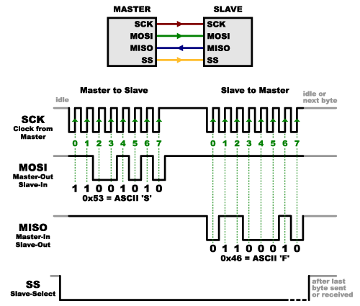
SPI Protocol
Clock is generated by the master

Slide 6
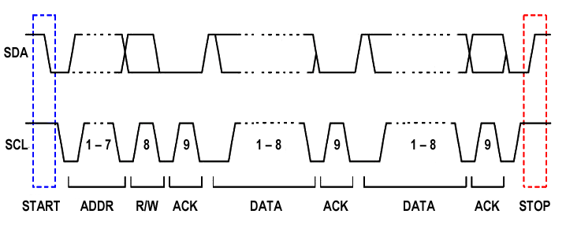
I2C Protocol
Master sends START condition and controls the clock (SCL)
Master sends a unique 7-bit slave address
Master sends Read/Write bit: 0 write to slave, 1: read from slave
Slave which address is matched send ACK bit
Data (8bit) is transfered

Slide 7
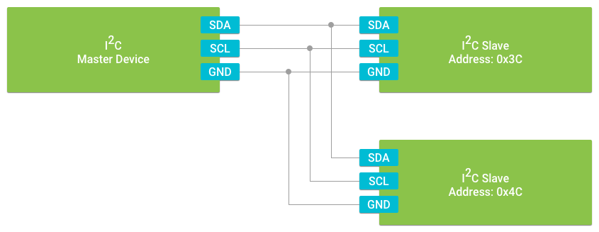
Implement I2C
I2C is a synchronous serial interface. The device in control of triggering the clock signal is known as the master. All other connected peripherals are known as slaves. Each device is connected to the same set of data signals to form a bus.
https://developer.android.com/things/sdk/pio/i2c

Slide 8
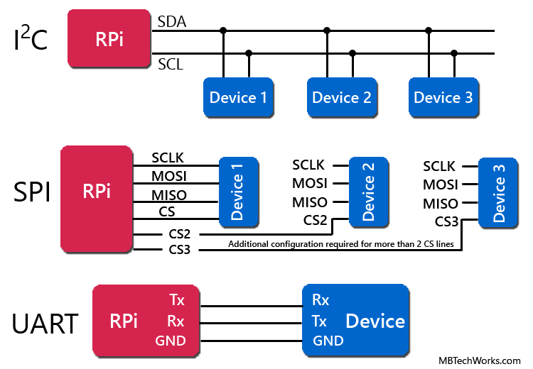
Summary
UART = Universal Asynchronous Receiver / Transmitter
SPI = Serial Peripheral Interface
I²C = Inter-Integrated Circuit

Slide 9
Serial Communications Methods
Name | Description | Function
I²C | Inter-Integrated Circuit | Half duplex, serial data transmission used for short-distance between boards, modules and peripherals. Uses 2 pins.
SPI | Serial Peripheral Interface bus | Full-duplex, serial data transmission used for short-distance between devices. Uses 4 pins.
UART | Universal Asynchronous Receiver-Transmitter | Full-duplex, Asynchronous, serial data transmission between devices. Uses 2 pins.

Slide 10
Conclusion
UART - simple; not high speed; no clock needed; limited to one device, but long range communication
I2C - faster than UART, but not as fast as SPI; easier to chain many devices; Pi drives the clock so no sync issues.
SPI - fastest of the three; Pi drives the clock so no sync issues; practical limit to number of devices on the Pi.

